Slide 1
Review-2 on Stroke Prediction Using Machine Learning Ensemble Methods
Y. Mrudula(2010030571)
R. Sreenik Goud(2010030527)
S. Kowshik Goud(2010030558)
B. Dinesh Yadav(2010030387)
Under the Guidance of
Dr. PAVAN KUMAR PAGADALA
ASSISTANT PROFESSOR
Computer Science and Engineering Department
KL Hyderabad Off Campus, Aziz Nagar ,Hyderabad

Slide 2
Overview
Abstract
Introduction
Literature Review
Problem Statement
Objectives of the Project
Proposed Methodology/Architecture/Algorithm/Technique/etc
References

Slide 3
Introduction
Introduction In recent years, stroke has emerged as a significant health concern worldwide, leading to substantial morbidity, mortality, and economic burden.
Prompt identification of individuals at risk of stroke is crucial for implementing preventive measures and improving patient outcomes. Machine learning techniques have shown promise in aiding stroke prediction by leveraging various risk factors and clinical data.
Over the years, various machine learning methods, have changed to deep learning which have proven that they have more advantage over traditional machine learning methods in terms of accuracy and speed of prediction.
Machine learning regression models offer a powerful framework for analyzing complex datasets and identifying patterns that may not be apparent through traditional statistical methods.
By training on historical data containing information about individuals who have experienced strokes and those who have not, regression models can learn to predict the likelihood of stroke occurrence in new cases based on a set of input features..
We will highlight the significance of accurate stroke prediction in clinical practice and its implications for public health interventions.

Slide 4
Problem Statement
Despite advancements in medical research and healthcare, strokes continue to pose a significant threat to global public health, leading to substantial morbidity, mortality, and healthcare costs.
Early identification of individuals at high risk of stroke is crucial for implementing preventive interventions and reducing stroke-related burdens. However, existing risk assessment tools and predictive models may have limitations in accurately stratifying stroke risk in diverse populations, considering evolving risk factors, and enabling timely intervention.
Therefore, there is a pressing need to develop and validate robust, reliable, and accessible methods for stroke prediction that can enhance risk stratification, facilitate personalized preventive strategies, and ultimately reduce the incidence and impact of strokes on individuals and healthcare systems.

Slide 5
Objectives of the Project
The objectives of stroke prediction encompass several key goals aimed at improving patient outcomes, reducing the burden of stroke-related morbidity and mortality, and optimizing healthcare resource utilization. Here are some common objectives:
Early Identification of High-Risk Individuals: Develop methods and tools to accurately identify individuals at high risk of experiencing a stroke before the onset of symptoms.
Risk Stratification: Stratify individuals into different risk categories based on their likelihood of experiencing a stroke within a defined time frame (e.g., 5 years, 10 years).
Personalized Risk Assessment: Tailor stroke risk assessment to individual characteristics, including demographics, medical history, lifestyle factors, genetic predisposition, and biomarker profiles.
Improved Accuracy and Reliability: Enhance the accuracy and reliability of stroke prediction models by incorporating novel risk factors, leveraging advanced statistical and machine learning techniques, and validating models in diverse populations.
Ensemble Methods: In this project we have combined many algorithms like SVM, Logistic regression, Decision trees and Random forest to get better results.

Slide 6
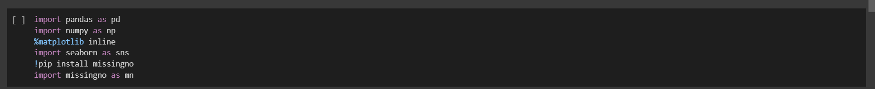
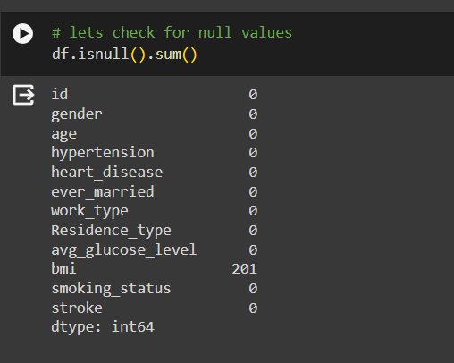
Implementation Details

Slide 7
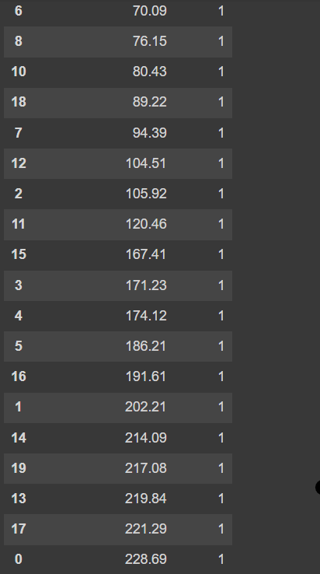
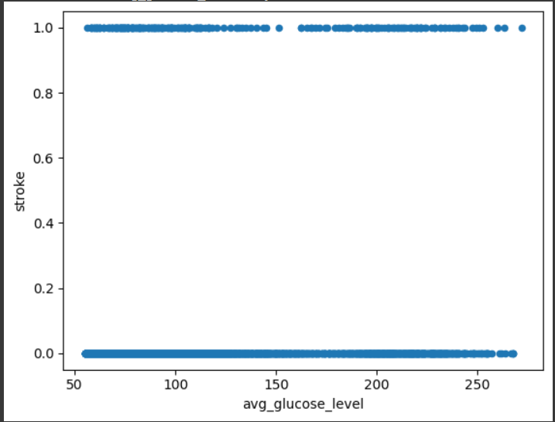
Results

Slide 8
Thank you

